Slide 1
The Battle of Neighborhoods
Sahil Paryani

Slide 2
Agenda
Introduction
Data Description
Map of Scarborough
Methodology
Results
Conclusion

Slide 3
Introduction
Purpose: Assist people in exploring better facilities around their neighborhood
Location: Scarborough, Toronto, CA
Features/Facilities Analyzed: Median housing price and better school consistent with ratings, crime rates of that specific area, road connectivity, weather, good management for emergency, water resources both fresh and wastewater and excrement conveyed in sewers and recreational facilities

Slide 4
Data Description
Dataset consisting of latitude and longitude, zip codes of Scarborough, Canada after cleaning in the 3rd week of Capstone.
We will need data about different venues in different neighborhoods of that specific borough. In order to gain this information, we are using "Foursquare" locational information. Foursquare is a very gigantic location data provider with information about all sorts of venues and events within any area. Such information includes venue names, locations, menus, photos and even reviews. As such, the foursquare location platform will be used as the sole data source, As all information we need is provided by foursquare there will be no need to rely on other data sources.
After connecting to the Foursquare API to gather information about venues inside each neighborhood. For each neighborhood, the data retrieved from Foursquare contains information of venues within a specified distance of the longitude and latitude of the postcodes.
The data for every venue is as follows:
•Neighborhood
•Neighborhood Latitude
•Neighborhood Longitude
•Venue
•Name of the venue
•Venue Latitude
•Venue Longitude
•Venue Category

Slide 5
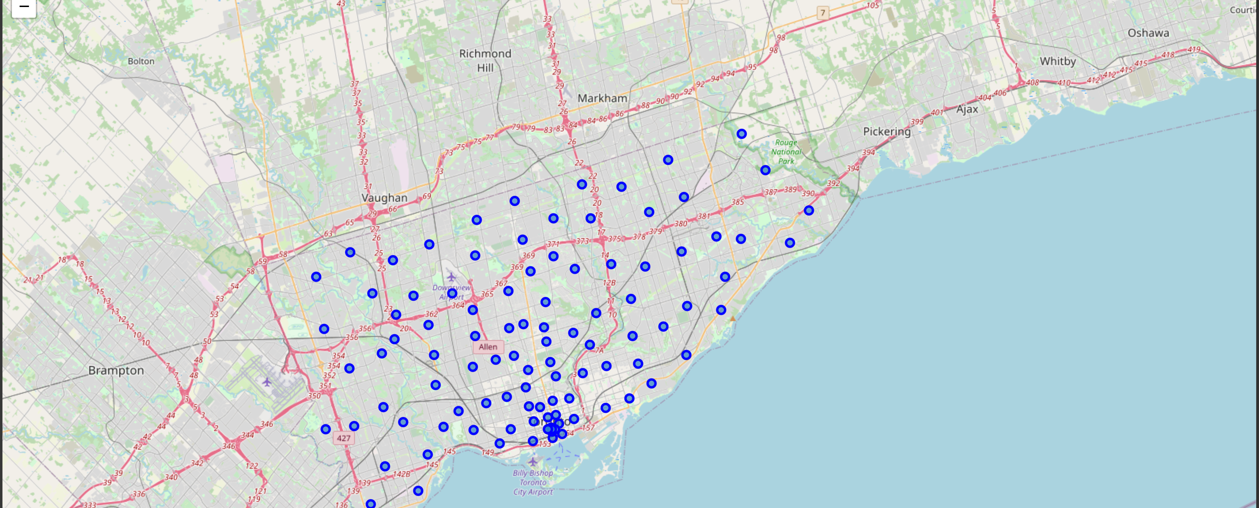
Map of Scarborough

Slide 6
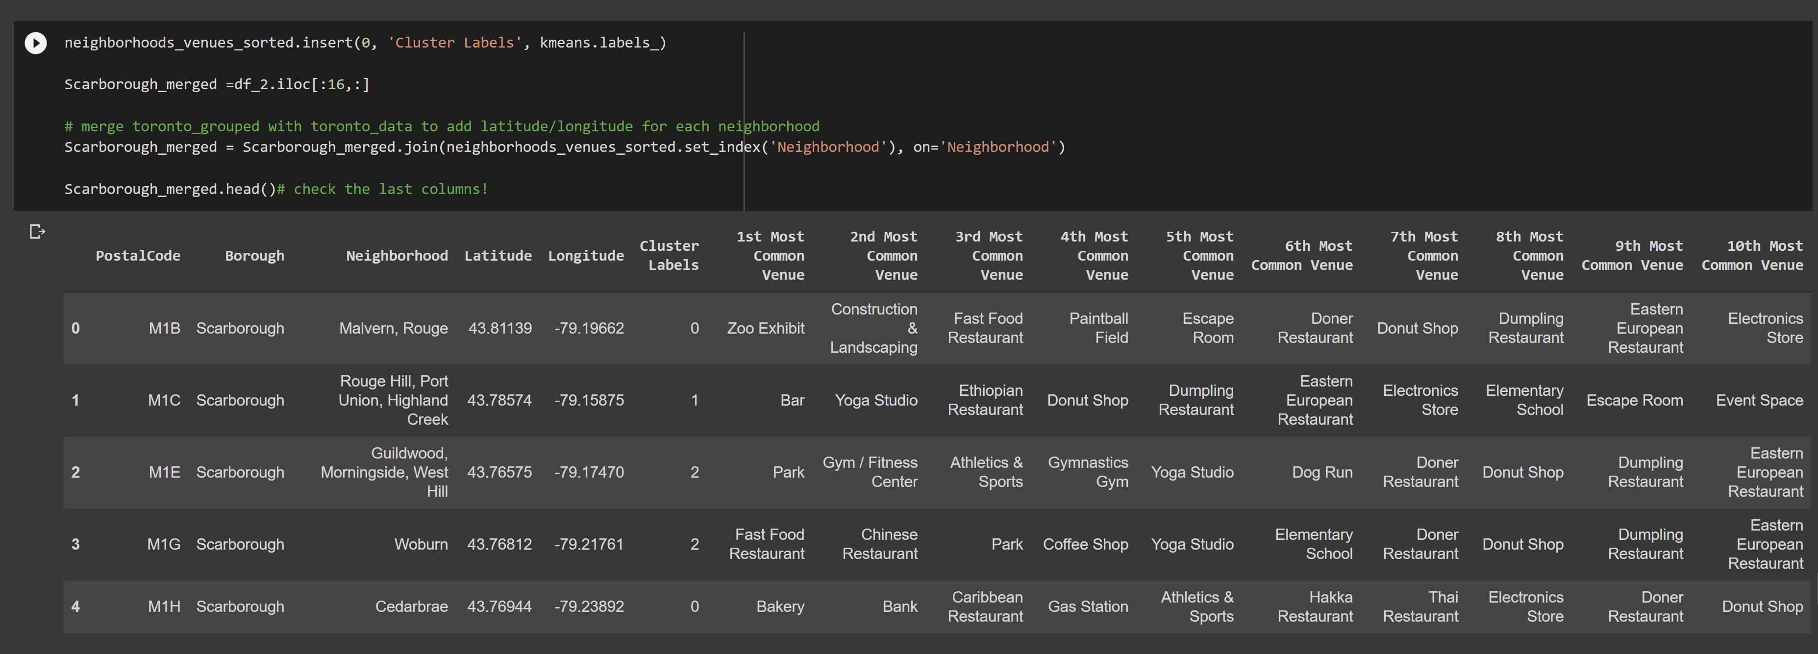
Methodology
I used K-means clustering to segment the big city into smaller clusters that basically group neighborhoods that have similar properties in terms of venues present near them. I formed 3 clusters. To be able to do that I ran K-means clustering algorithm and assigned cluster labels to each row so as to classify that neighborhood. I also managed to find out the Top 10 most common venues in every neighborhood. This data was helpful in forming clusters.

Slide 7
Results
The Location:
Scarborough may be a popular destination for brand spanking new immigrants in Canada to reside. As a result, it is one among the foremost diverse and multicultural areas within the Greater Toronto Area, being home to varied religious groups and places of worship. Although immigration has become a hot topic over the past few years with governments seeking more restrictions on immigrants and refugees, the overall trend of immigration into Canada has been increasing.
Foursquare API:
The project has extensively used the foursquare API for location data as the database has extensive data on millions of venues worldwide. The Places API offers real-time access to Foursquare’s global database of rich venue data and user content to power your location-based experiences in your app or website.

Slide 8
Conclusion
In battle of the neighborhoods, I used k-means cluster algorithm and separated the neighborhood into 10(Ten) different clusters for all the 103 different latitude and longitude that I could find on the Wikipedia page, forming groups/clusters based on common venues present near those neighborhoods. Using charts, I have presented the average house pricing and the school ratings in these neighborhoods to help the person moving to Scarborough in getting extra information that might affect his/her selection of neighborhood.
It was great working on such a unique project. It helped me learn a lot in terms of how data science helps us in day to day. I have worked hard on this and I won't lie It took a lot of time but at the same time This course was worth it. All the new tools that I used here for web-scraping, geospatial data, real-live maps will help me in the future.

Slide 9
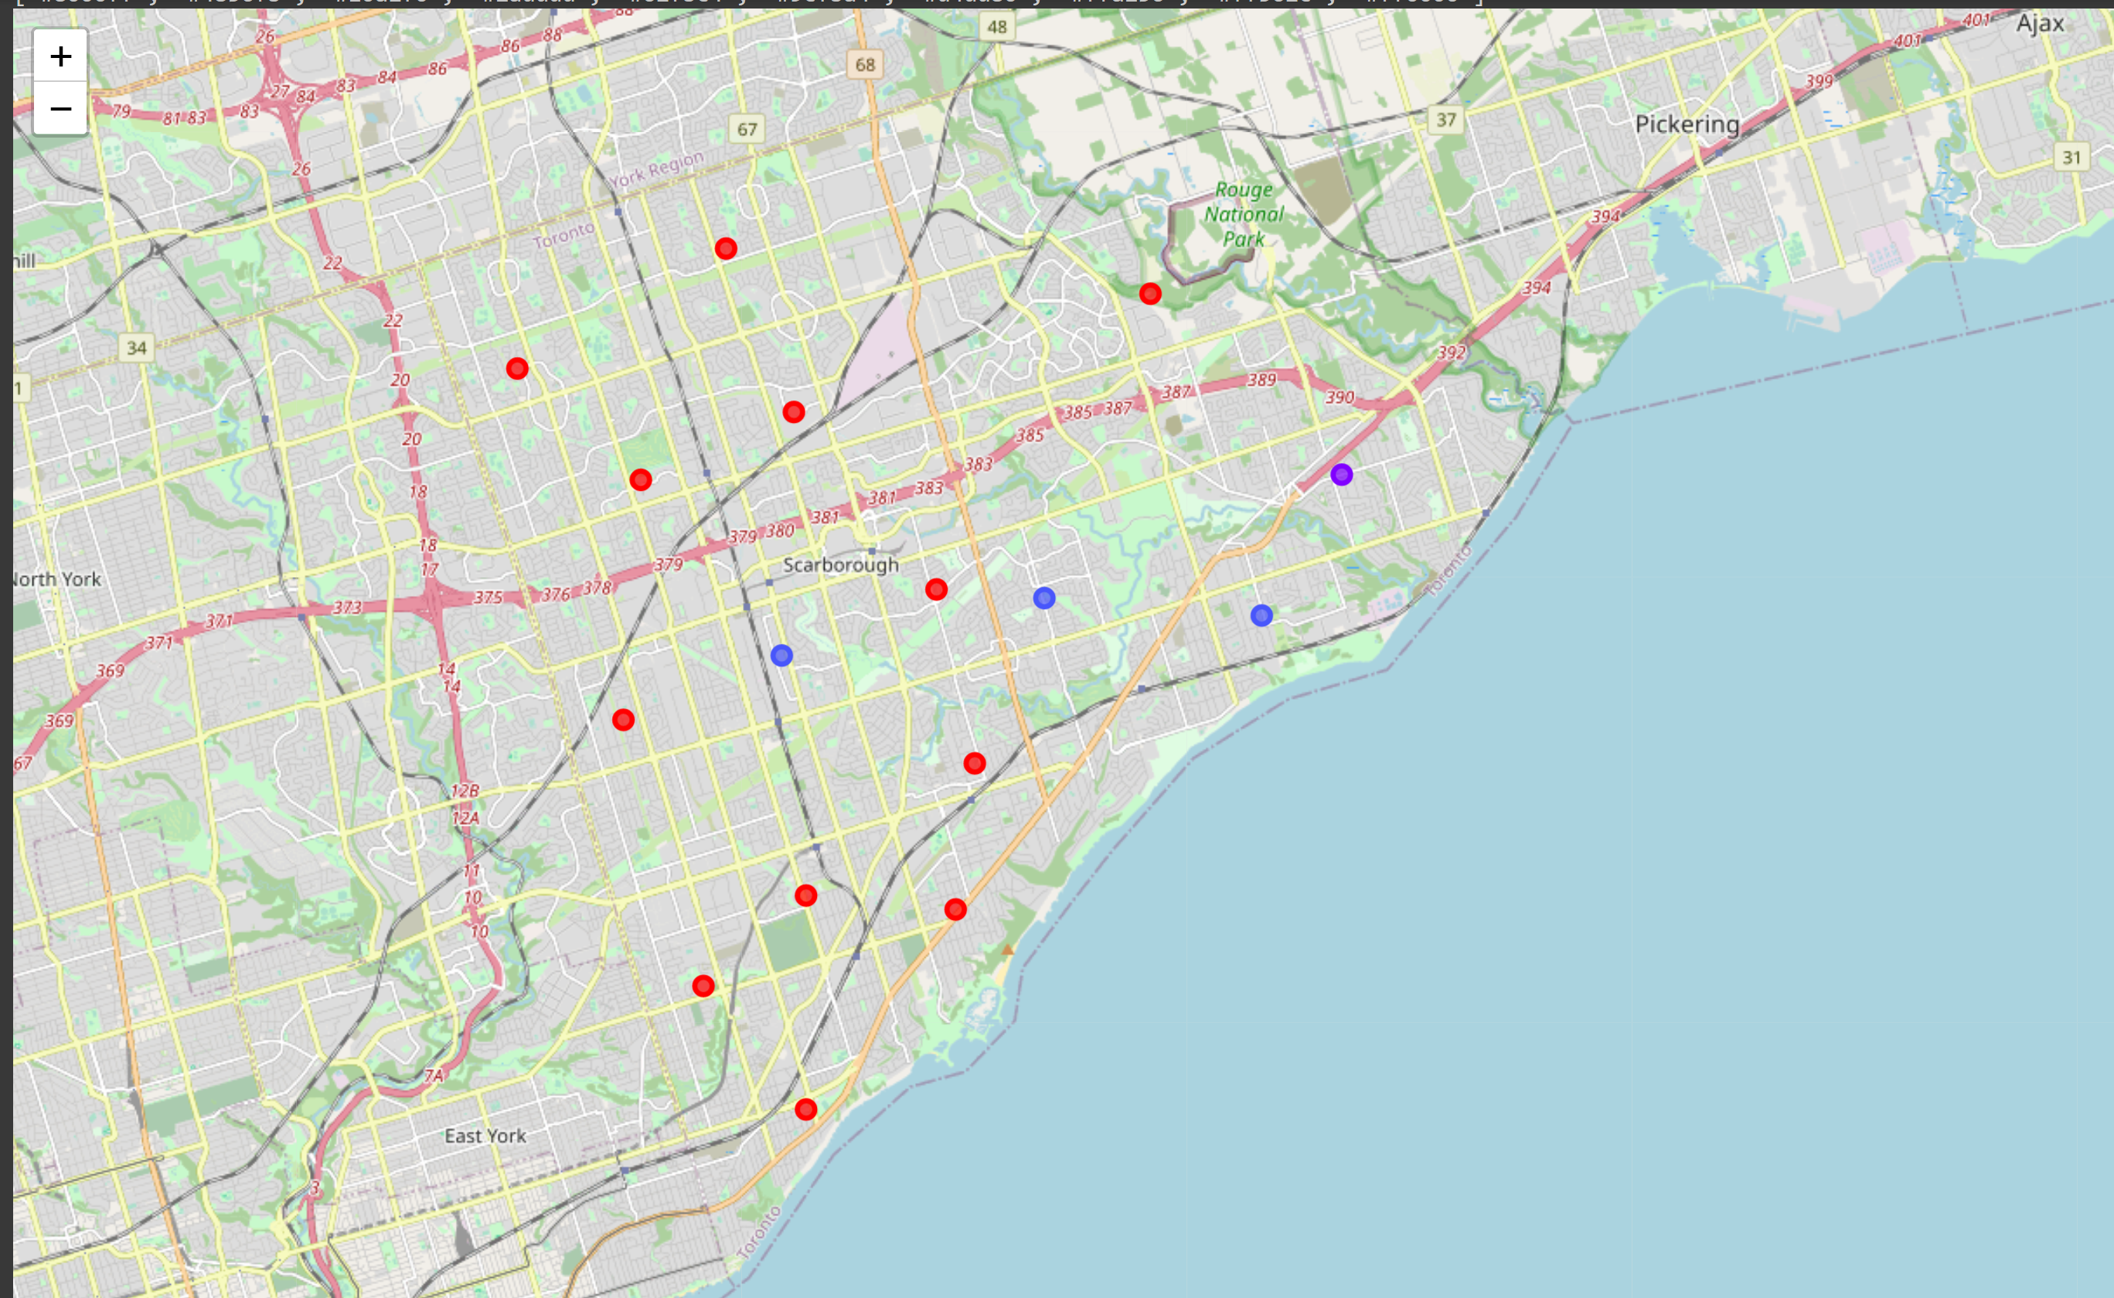
Appendix
Map of clusters (3) formed using K-means in Scarborough

Slide 10
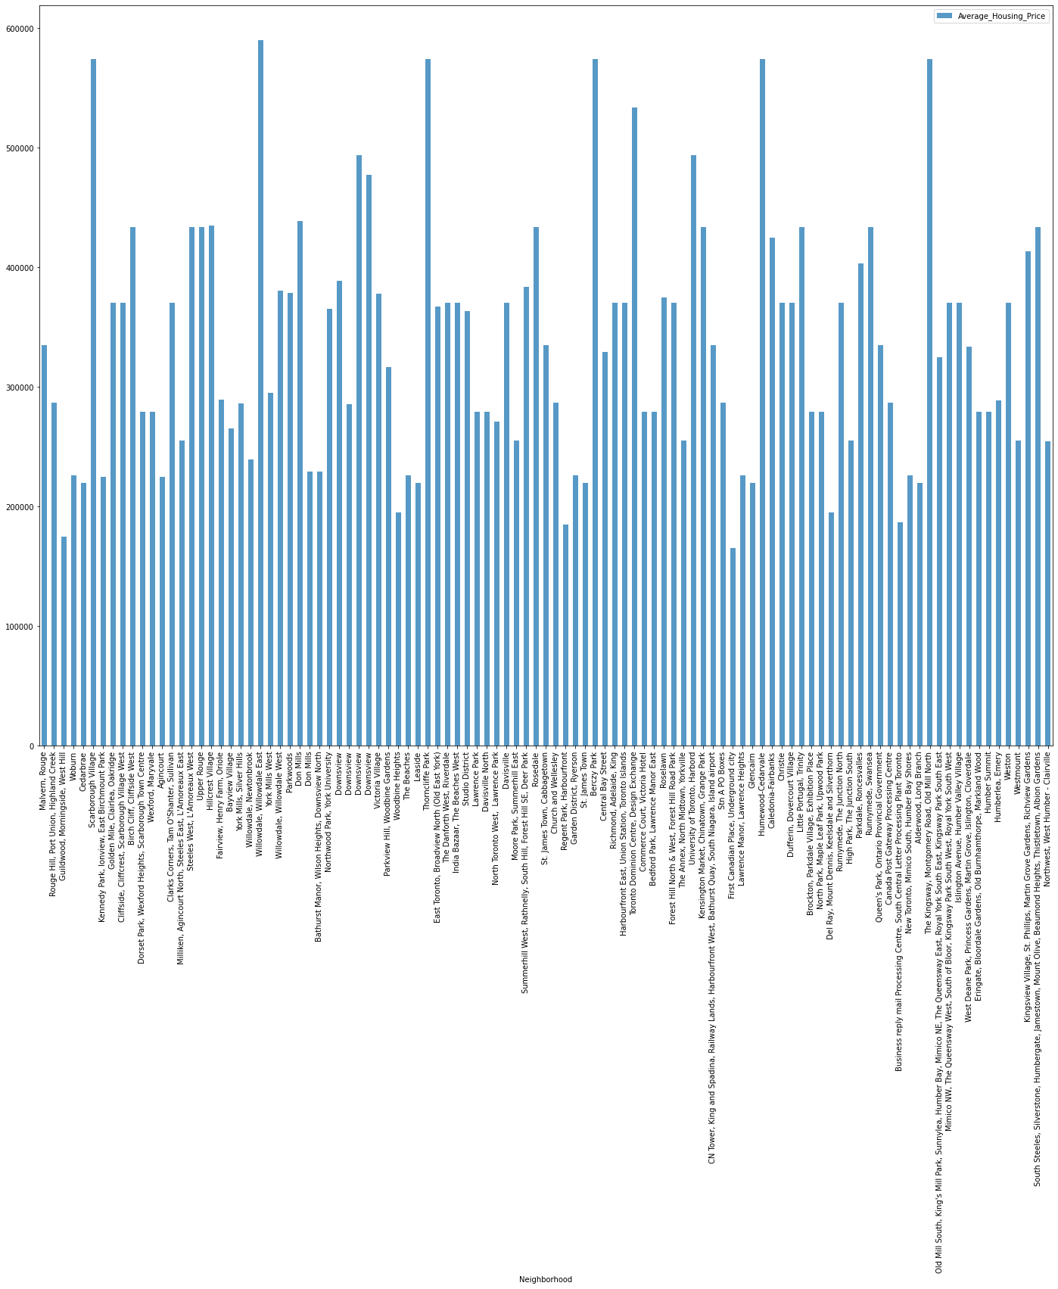
Appendix
Average House pricing in Scarborough by clusters

Slide 11
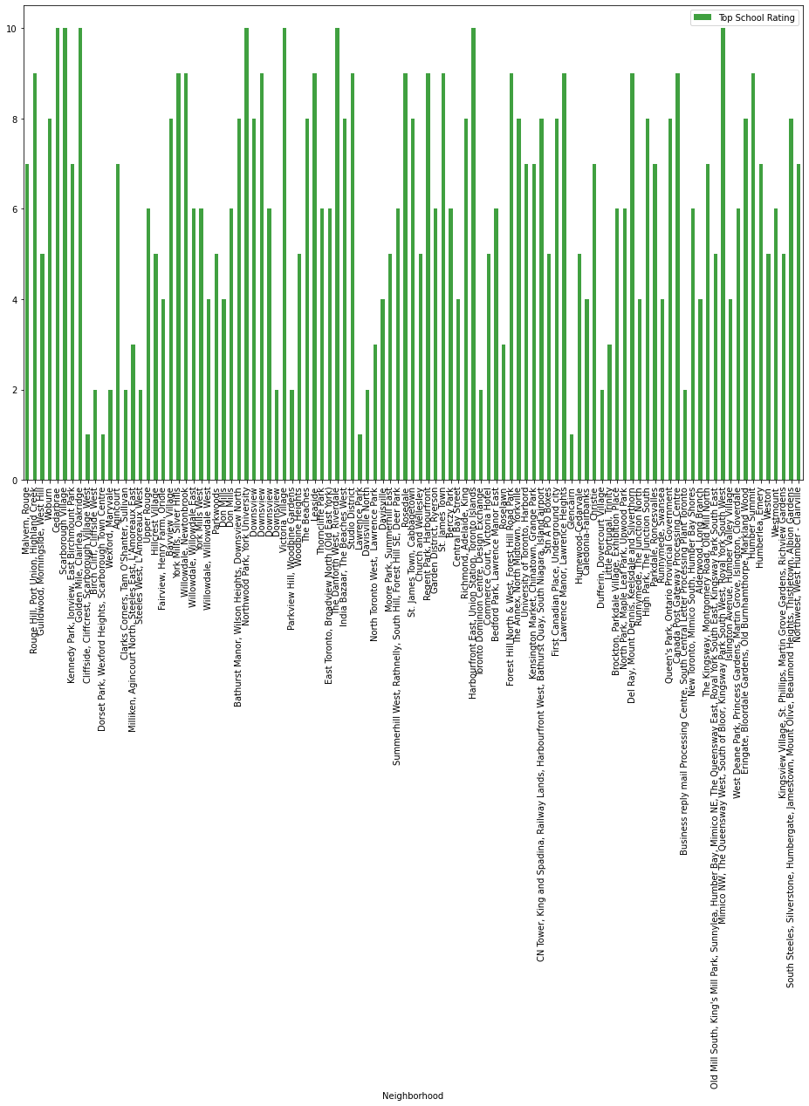
Appendix
School ratings in Scarborough by clusters

